Slide 1
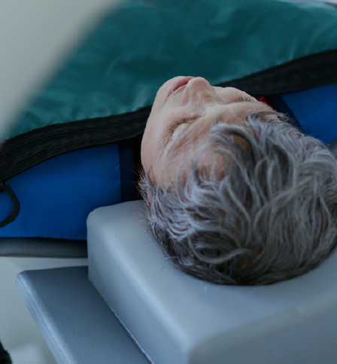
Medical Care Optimization Model for Traumatic Brain Injuries
EE 608 Spring 2021

Slide 2
The Problem
Traumatic Brain Injury (TBI) leads to deaths and disabilities numbering in the thousands every year
Approximately 150 Americans die from TBI-related injuries each day
During 2014, nearly 2.87 million TBI-EDHDs were reported in the U.S., of which 837,000 cases were related to children

Slide 3
Current Approaches
TBIs are classified using twelve codes from the International Classification of Diseases, Ninth Edition, Clinical Modification (ICD-9-CM) and treated accordingly. A few examples of the codes are listed below:
800: fracture of vault of skull
801: fracture of the base of skull
803: other and unqualified skull fractures
804: multiple fractures involving skull or face with other bones

Slide 4
Innovation

Slide 5
Who Cares?
Traumatic Brain Injury creates a public health concern with serious consequences that touches the lives of our family members and people living in our communities
Literally anyone could be affected by TBI in the duration of their lives since the major causes of TBI include unintentional falls, being unintentionally struck by or against an object, and car crashes

Slide 6
Limitations
The data does not include the people who did not look for medical help at all, or did not visit hospitals and instead received medical help from one of the following providers: primary care, urgent care or specialty care
The data does not provide detailed information regarding the treatments of the most common causes of TBIs leading to death, such as intended self-harm, unplanned falls, and motor vehicle crashes

Slide 7
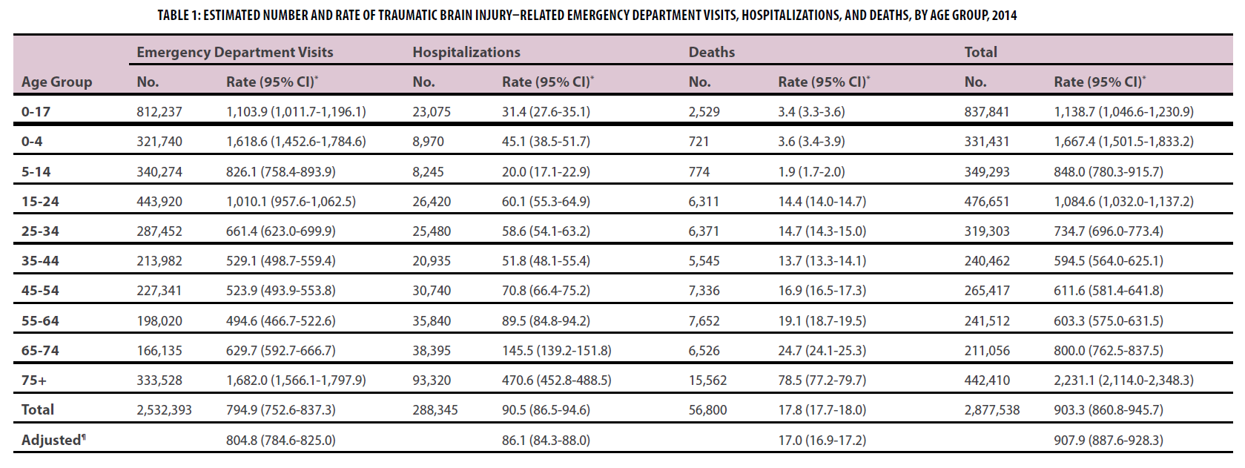
The Data Collected

